Slide 1
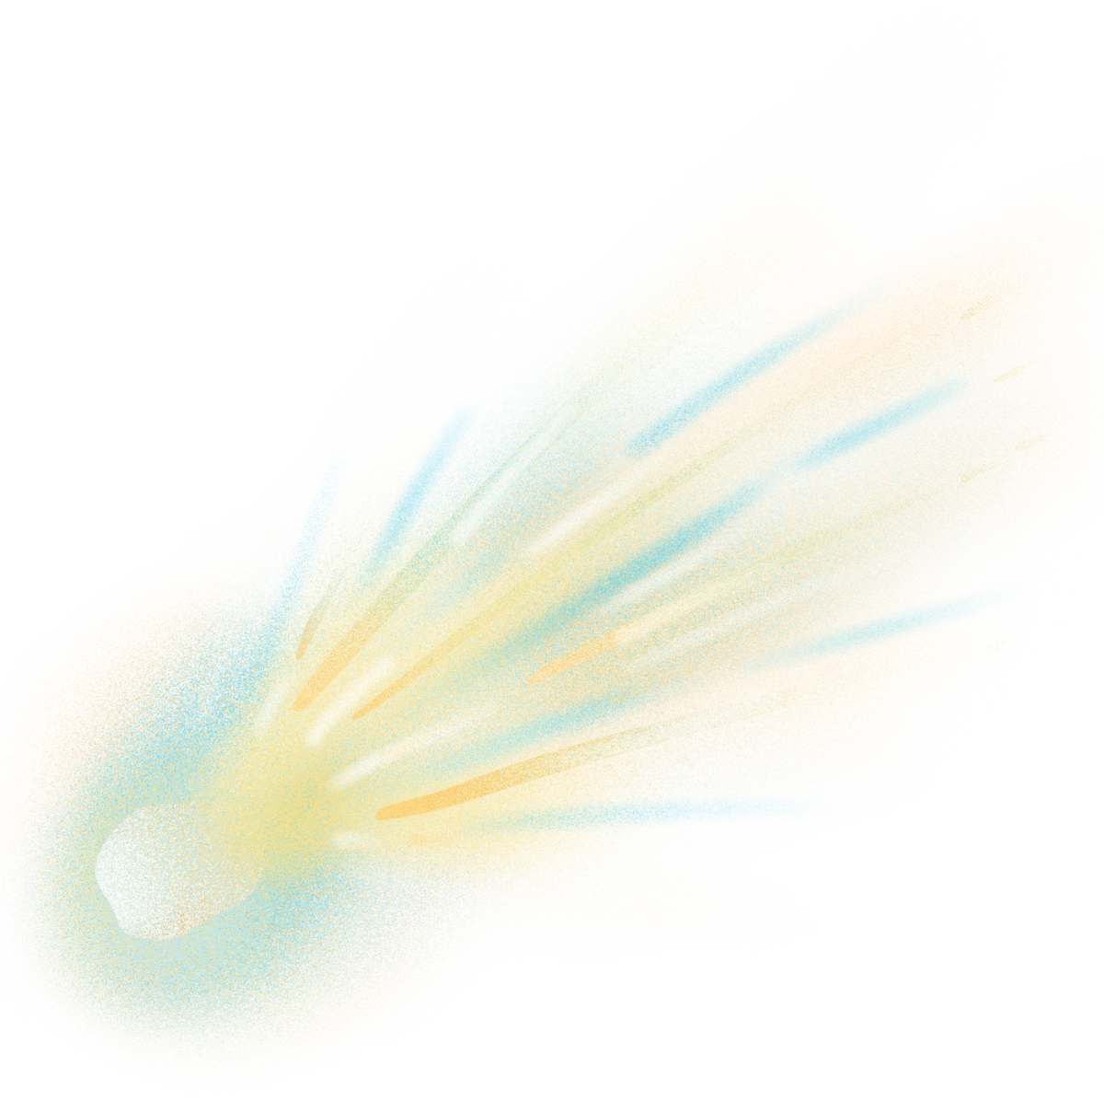
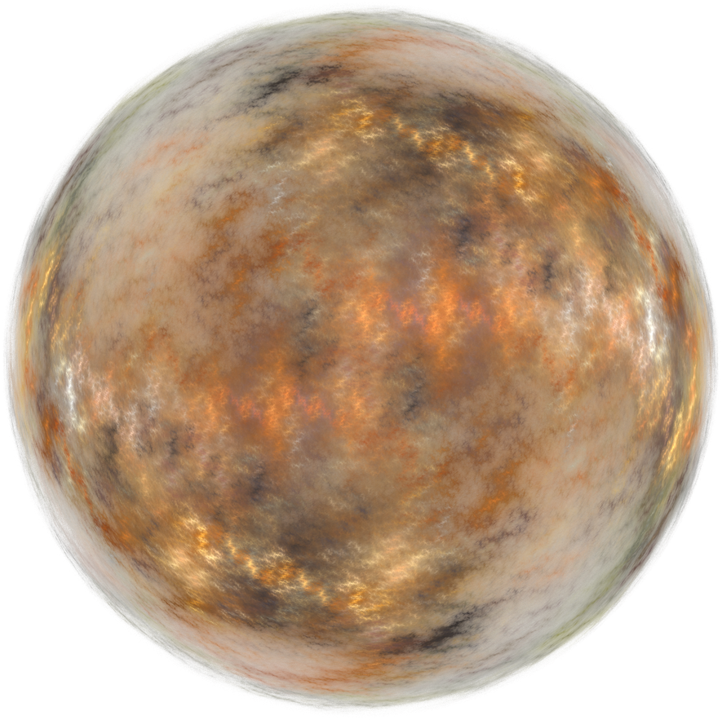

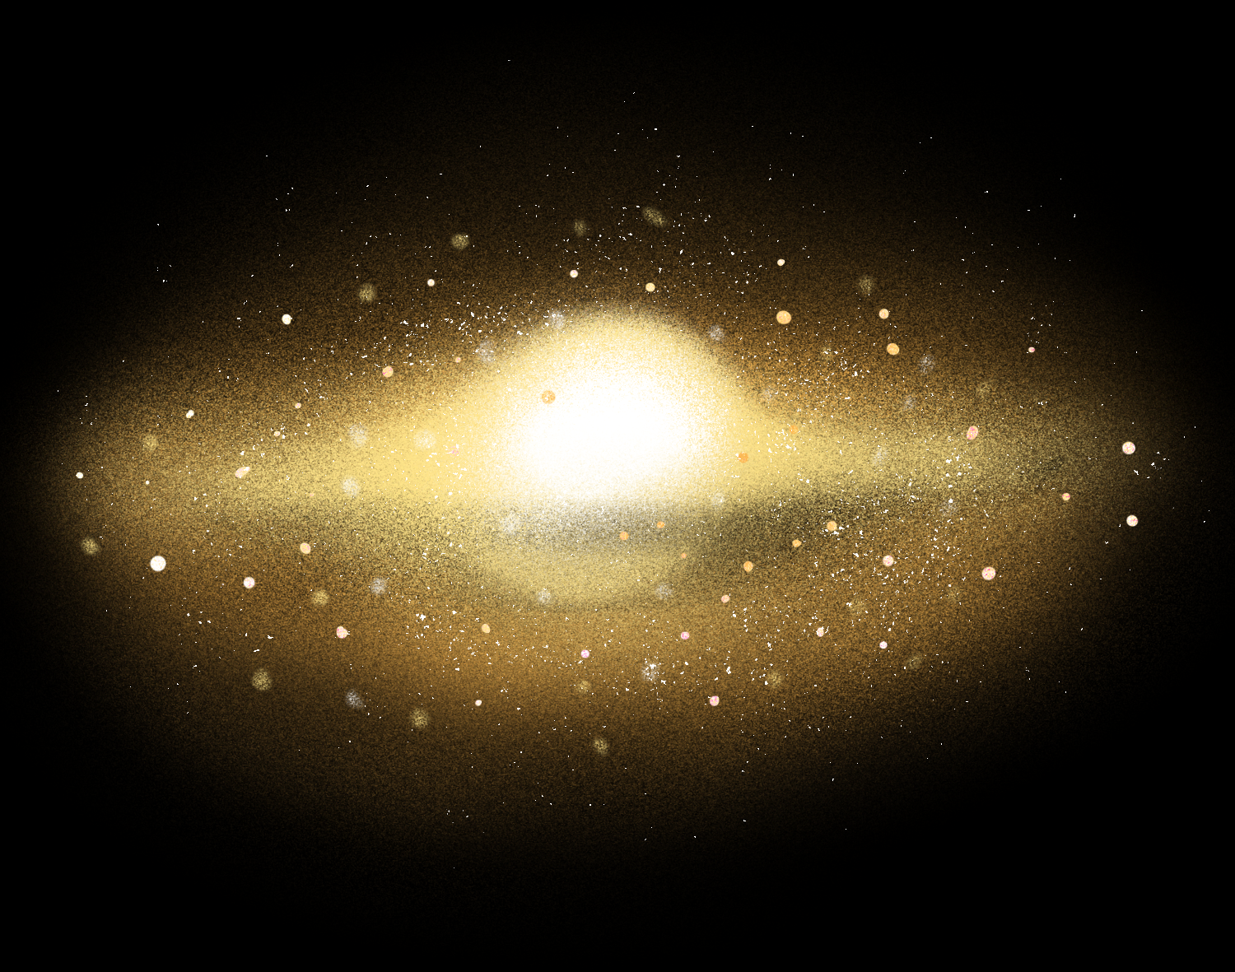
ROCK
FALL
STEP BY STEP PROCESS
By: Chelsea Pascua
Calvin Antoniio
Johnwell De Lune

Slide 2
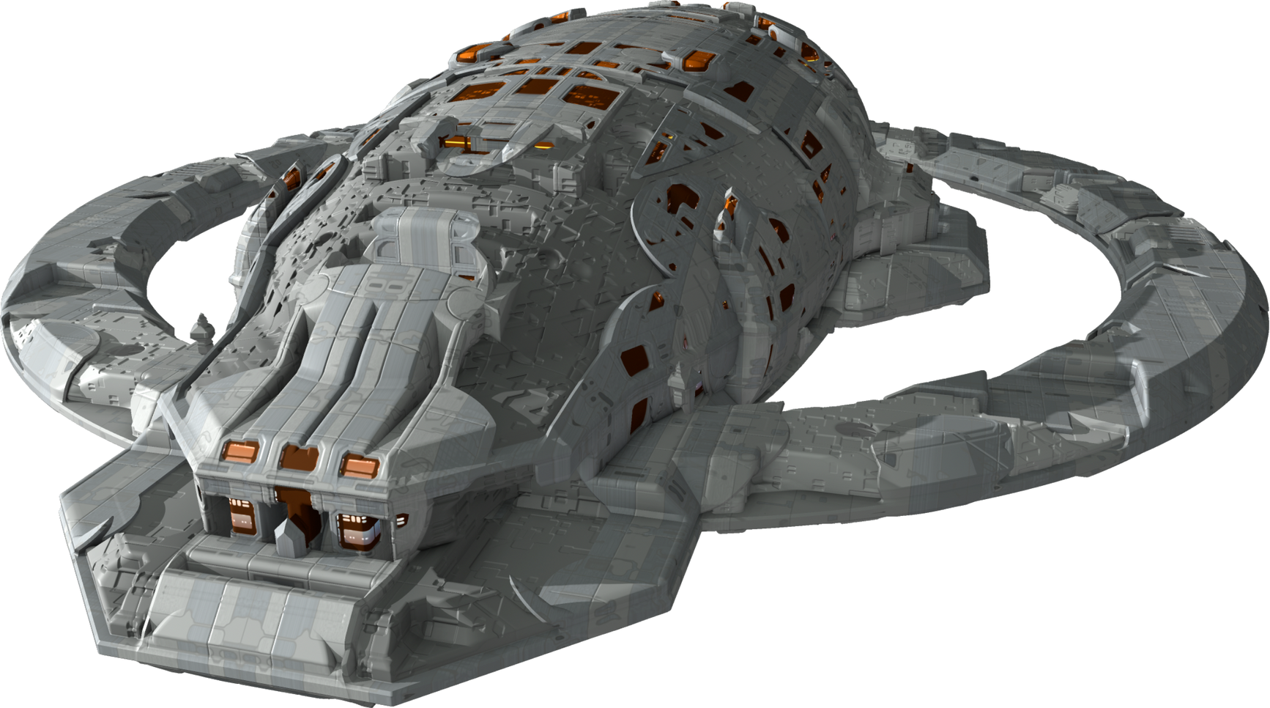
ARE YOU READY?

Slide 3
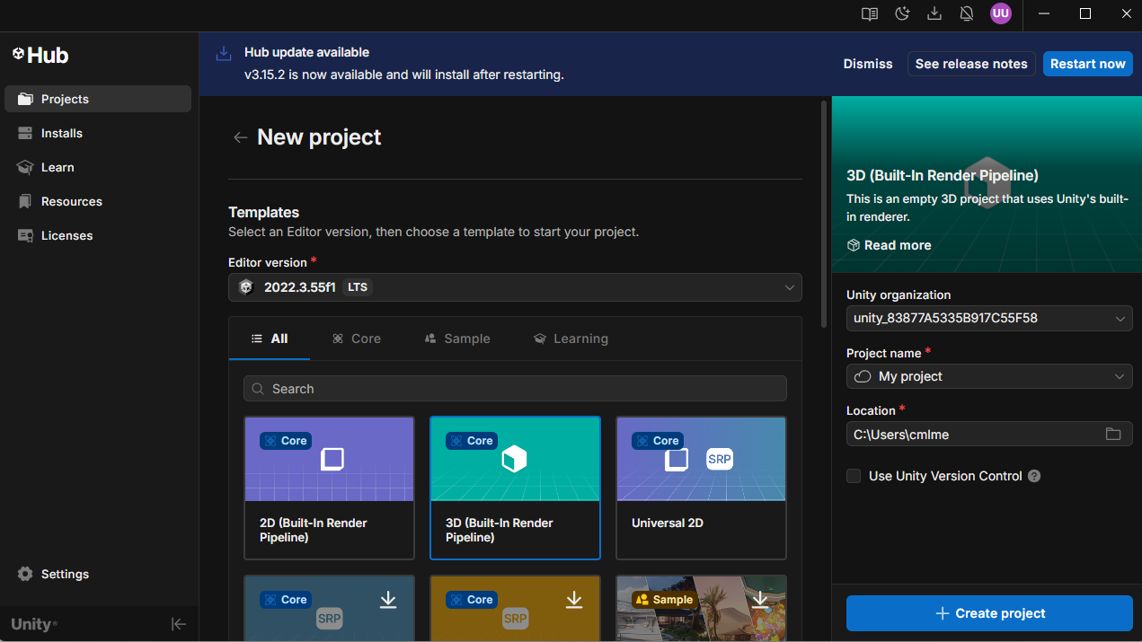
1. CREATE THE PROJECT
I OPEN UNITY HUB AND CLICK NEW PROJECT → 3D.
I NAME THE PROJECT ROCKFALL AND CLICK CREATE.

Slide 4
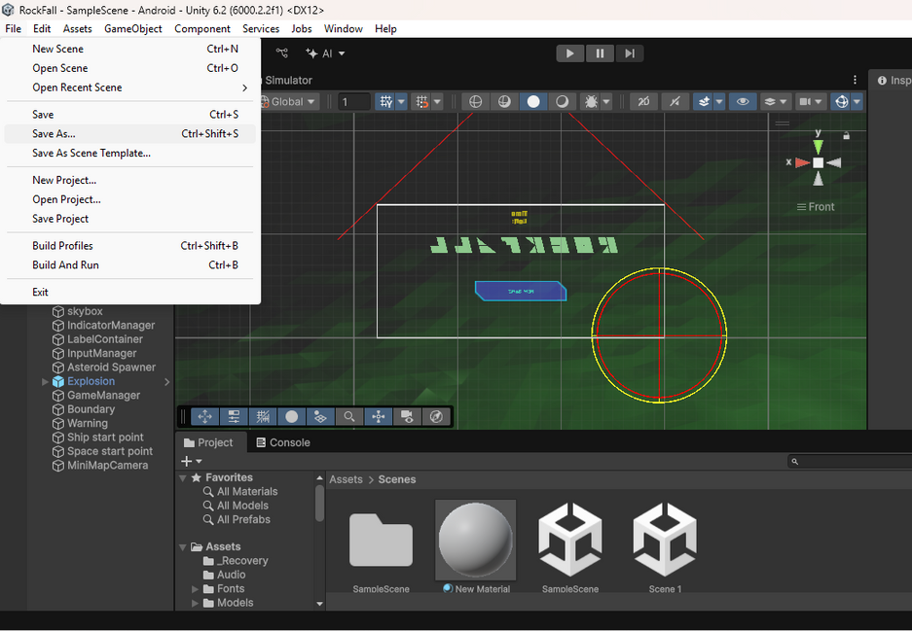
2. SAVE THE NEW SCENE
AFTER THE PROJECT OPENS, I GO TO FILE → SAVE AS….
I NAVIGATE TO THE ASSETS FOLDER AND SAVE THE SCENE AS MAIN.UNITY

Slide 5
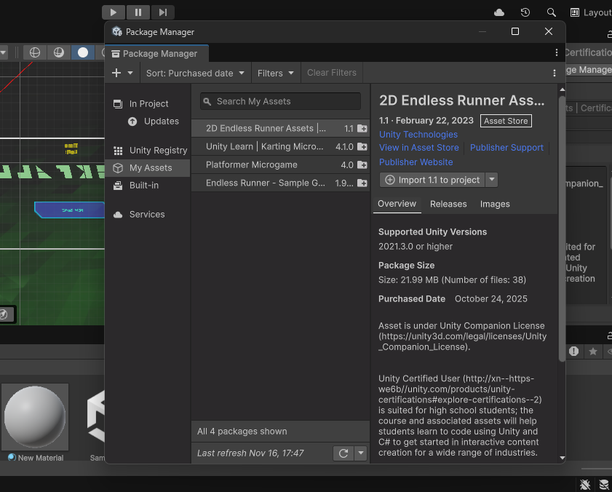
3. IMPORT THE DOWNLOADED ASSETS
I DOUBLE-CLICK THE DOWNLOADED .UNITYPACKAGE AND IMPORT ALL ASSETS.
I WAIT FOR UNITY TO FINISH IMPORTING AND CONFIRM THE ASSETS APPEAR IN THE PROJECT WINDOW.

Slide 6
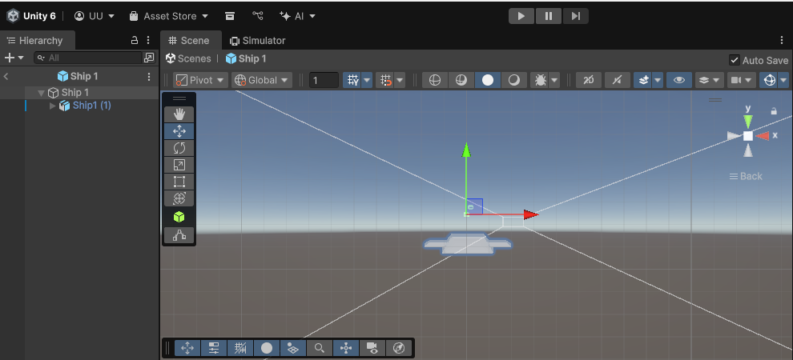
4. CREATE THE SHIP OBJECT
I create an empty GameObject named Ship (GameObject → Create Empty) and set its transform to 0,0,0.
I drag the ship model (from Assets → Objects or Models) into the Ship GameObject as a child (or replace the empty’s mesh).
I add components: Rigidbody (use Use Gravity = false for space feel) and appropriate Collider (e.g., BoxCollider or MeshCollider).
I add a script component ShipController (or my movement script) and set default values: moveSpeed = 10, turnSpeed = 80, tiltAmount = 15, smoothRotation = 5.

Slide 7
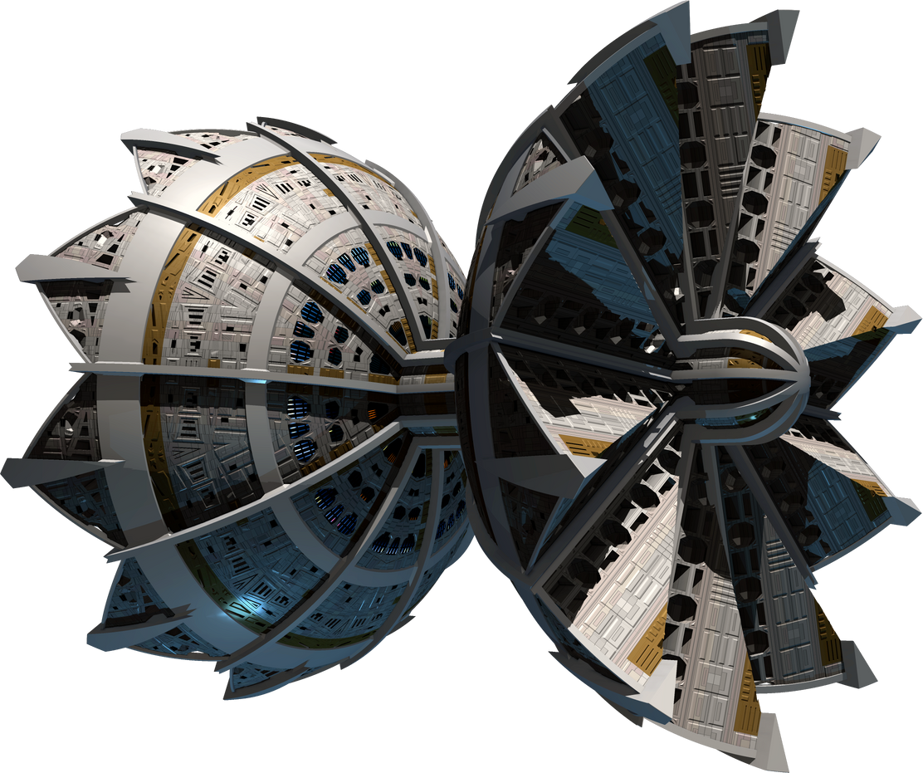
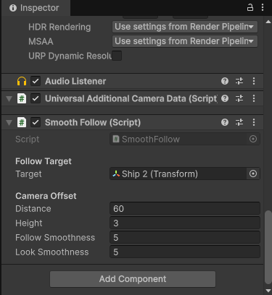
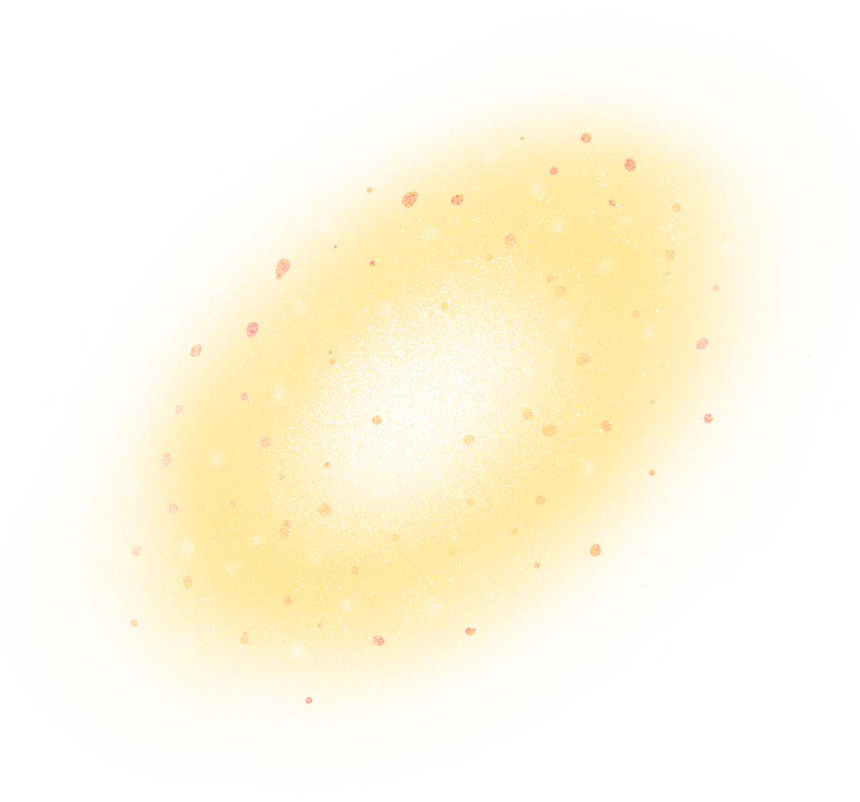
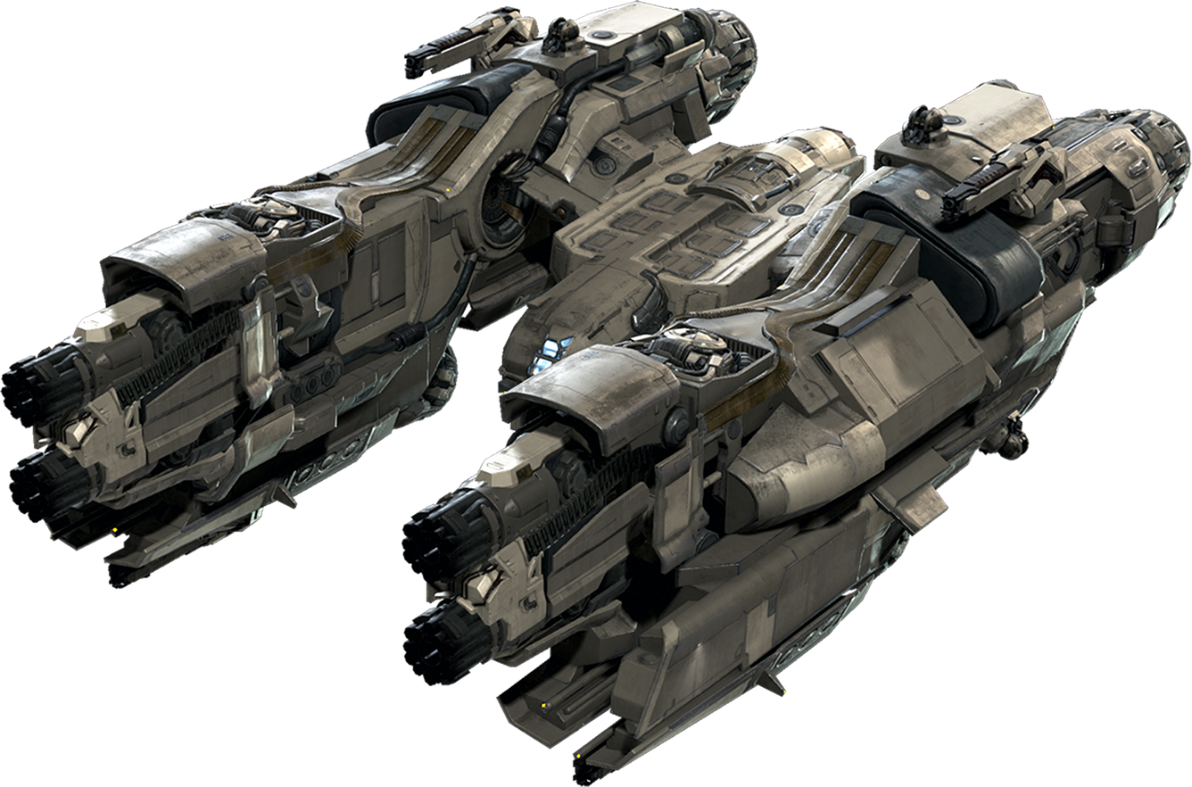
5. MAKE THE CAMERA FOLLOW THE SPACESHIP
I create an empty GameObject named CameraRig or attach directly to the Main Camera.
I add (or create) a SmoothFollow script and set its target to the Ship transform.
I set distance = 10, height = 3, followSmoothness = 5, lookSmoothness = 5.
I place the Main Camera under CameraRig (if using a rig) and confirm in Play that the camera tracks the ship.

Slide 8
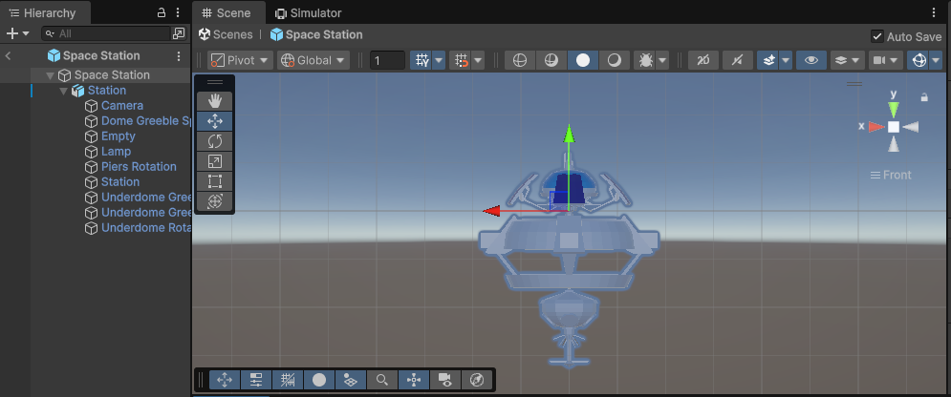
6. CREATE THE SPACE STATION
I DRAG THE SPACESTATION PREFAB INTO THE SCENE AND NAME THE ROOT SPACESTATION.
I position it at the desired coordinates (e.g., 0,0,50).
I add a Collider aND DAMAGETAKING SCRIPT WITH HITPOINTS APPROPRIATE FOR GAMEPLAY (E.G., 50).
I MARK IT AS THE ASTEROID SPAWNER TARGET IF NEEDED.

Slide 9
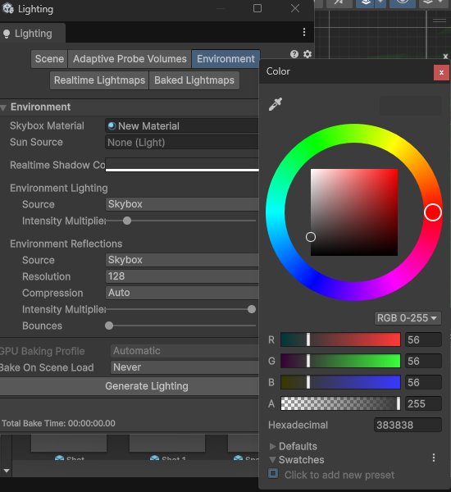
7. CREATE / ASSIGN THE SKYBOX
I open Window → Rendering → Lighting and in the Environment section I assign a skybox material (or Skybox in Render Settings).
I import or create a Skybox material (e.g., Materials → Create → Material → Shader Skybox/Procedural or HDRI skybox).
I tweak sky colors until the scene looks right.

Slide 10
8. CREATE THE CANVAS
I CREATE UI → CANVAS AND SET RENDER MODE = SCREEN SPACE - OVERLAY
I ADD A TEXT - TEXTMESHPRO ELEMENT FOR THE TIMER AND NAME IT TIMERTEXT; ANCHOR IT TOP-CENTER.
I ADD OTHER UI PANELS: INGAMEUI, PAUSEDUI, GAMEOVERUI, GAMEWINUI, MAINMENUUI AS CHILDREN OF THE CANVAS. I SET GAMEOVER AND GAMEWIN INACTIVE BY DEFAULT.

Slide 11
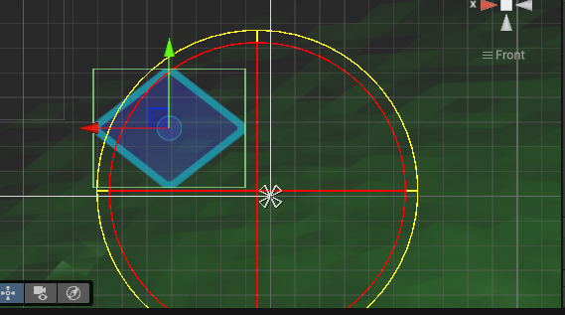
9. ADD THE JOYSTICK (VIRTUAL)
I CREATE A PANEL UNDER CANVAS NAMED JOYSTICKBG. I SET IT SIZE TO 200X200 AND ANCHOR BOTTOM-LEFT.
INSIDE IT I CREATE AN IMAGE THUMB (CHILD) AND POSITION ANCHORED CENTER.
I ADD A VIRTUALJOYSTICK SCRIPT TO JOYSTICKBG
IN THE VIRTUALJOYSTICK INSPECTOR I ASSIGN _THUMB TO THE THUMB RECTTRANSFORM AND TWEAK RADIUS IF NEEDED.

Slide 12
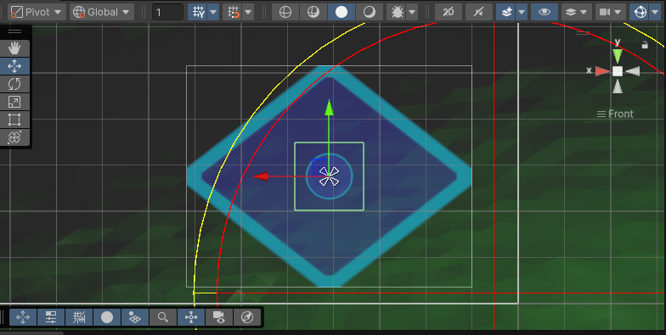
10. CREATE THE THUMB (VISUAL)
I ENSURE THE THUMB IMAGE USES A CIRCULAR SPRITE AND SET COLOR TO SEMI-TRANSPARENT WHITE.
I SET RECTTRANSFORM ANCHORED POSITION = 0,0 AND SIZE = 64X64.

Slide 13
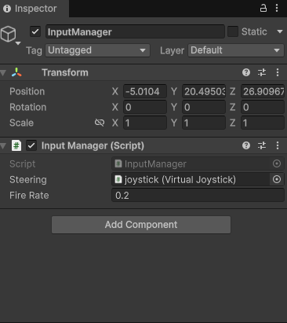
11. CREATE THE INPUT MANAGER
I create a GameObject InputManager and add my InputManager script (singleton).
I wire it to reference the VirtualJoystick by dragging the joystick object into the steering field (or register it at runtime).

Slide 14
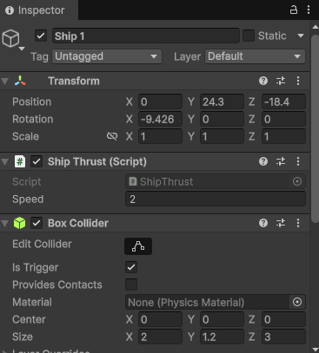
12. FLIGHT CONTROL (HOOK SCRIPTS)
I attach the ShipController (or combined movement script) to the Ship root.
I ensure InputManager.instance is set up and InputManager.instance.steering is assigned so GetInputDirection() returns joystick vector.
I test in Play: I move the on-screen joystick and confirm the ship turns and moves forward smoothly.

Slide 15
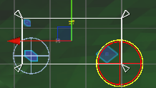
13. CREATE UI ELEMENTS (IN-GAME)
I CREATE HEALTH BARS, SCORE TEXT, AND THE TOP TIMER TEXT INSIDE INGAMEUI.
I USE TEXTMESHPRO FOR CRISP TEXT. I ANCHOR HUD ELEMENTS TO SAFE AREAS FOR DIFFERENT ASPECT RATIOS.

Slide 16
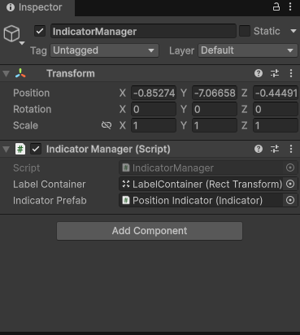
14. CREATE THE INDICATOR CONTAINER
I create an empty GameObject IndicatorContainer under Canvas for off-screen markers.
I add any child UI prefabs (icons) and an IndicatorManager script that will spawn and update them.

Slide 17
15. IMPLEMENT INDICATORMANAGER
I CREATE A C# INDICATORMANAGER SCRIPT THAT:
KEEPS A LIST OF TRACKED OBJECTS
CONVERTS WORLD POSITIONS TO SCREEN POSITIONS
COLORS ICONS AND SHOWS/HIDES THEM BASED ON DISTANCE OR OFF-SCREEN STATE
I ATTACH INDICATORMANAGER TO THE CANVAS AND SET INDICATORCONTAINER REFERENCE.

Slide 18
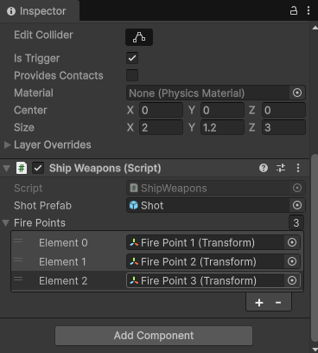
16. ADD WEAPONS AND TARGETING UI
I CREATE A FIREBUTTON UNDER CANVAS (UI → BUTTON) AND ANCHOR BOTTOM-RIGHT. I LABEL IT FIRE.
I CREATE A TARGETRETICLE (IMAGE) AND ANCHOR CENTER. I SET IT TO A CROSSHAIR SPRITE AND KEEP IT HIDDEN OR ACTIVE DEPENDING ON AIMING.
IN INPUTMANAGER OR UI EVENT, I CONNECT THE FIREBUTTON.ONCLICK TO SHIPWEAPONS.FIRE().

Slide 19
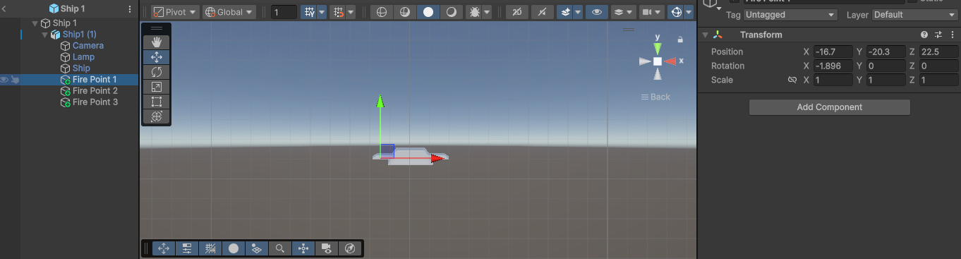
17. SHIPWEAPONS AND BULLET PREFAB
I CREATE A BULLET PREFAB SHOTPREFAB WITH A SPRITERENDERER OR SMALL MESH, RIGIDBODY AND SPHERECOLLIDER (ISTRIGGER = TRUE).
I ADD DAMAGEONCOLLIDE TO THE BULLET AND SET _DAMAGE = 1.
I ASSIGN SHOTPREFAB TO SHIPWEAPONS._SHOTPREFAB AND SET _FIREPOINTS TO CHILD TRANSFORMS BY THE SHIP'S GUNS.
I TEST FIRING; I SCALE BULLET OR ADD TRAIL TO MAKE VISIBLE.

Slide 20
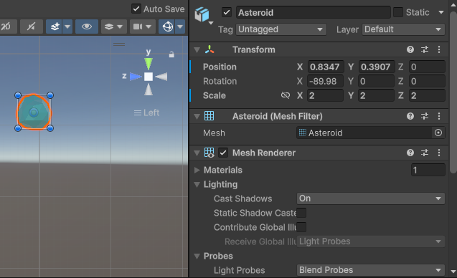
18. ASTEROIDS AND DAMAGE SYSTEM
I create an Asteroid prefab with Mesh, Rigidbody (non-kinematic or kinematic depending on method), and a Collider.
I add DamageTaking script and DamageOnCollide scripts where appropriate. I set asteroid hitPoints and ship damage.
I ensure collisions will fire: at least one side must have Rigidbody and colliders, or use trigger approach (bullet trigger + asteroid non-trigger collider).
I test destroying asteroids with bullets and ensure bullets call Destroy(gameObject) on hit.

Slide 21
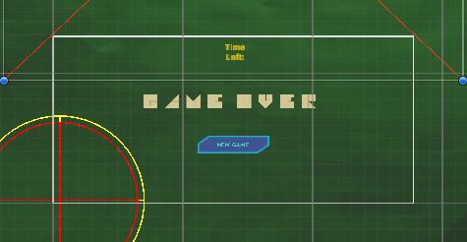
19. MENUS, DEATH, AND EXPLOSIONS
I create GameOverUI and GameWinUI panels with messages and a Restart button.
I create an Explosion prefab (Particle System + sound) and assign it to DamageTaking._destructionPrefab.
I ensure DamageTaking.TakeDamage() instantiates the explosion prefab before destroying the object.

Slide 22
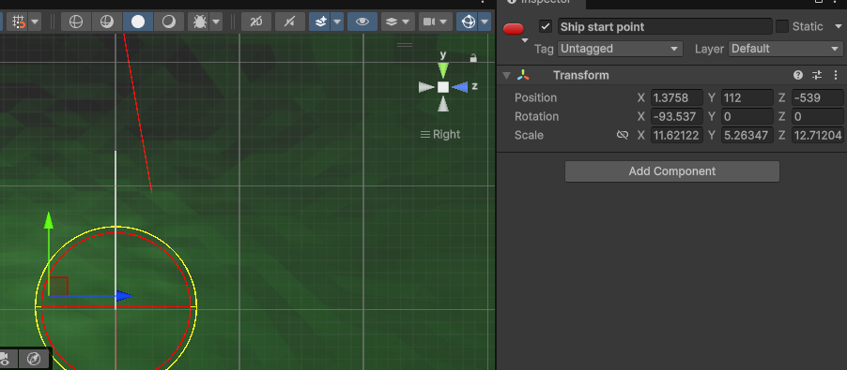
20. START POINTS
I CREATE EMPTY TRANSFORMS SHIPSTARTPOSITION AND SPACESTATIONSTARTPOSITION IN THE SCENE AND POSITION THEM.
I ASSIGN THESE TRANSFORMS TO GAMEMANAGER SO STARTGAME() SPAWNS THE SHIP AND STATION AT THE RIGHT LOCATIONS.

Slide 23
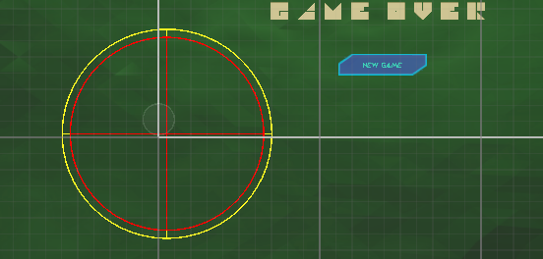
21. ADD THE WARNING SPRITE
I create a UI Image (under Canvas) named WarningUI and set a warning icon. I set it inactive by default.
In GameManager.Update() I toggle warningUI.SetActive(true/false) based on distance to the safe boundary.

Slide 24
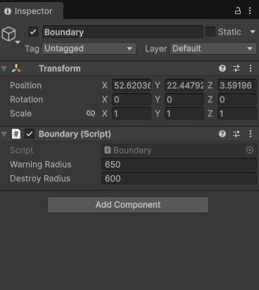
22. CODING THE BOUNDARY
I CREATE A BOUNDARY CLASS OR SCRIPTABLE OBJECT WITH WARNINGRADIUS AND DESTROYRADIUS.
I ADD A BOUNDARY GAMEOBJECT AT THE CENTER OF THE PLAY AREA AND ASSIGN IT TO GAMEMANAGER.BOUNDARY.
I IMPLEMENT THE LOGIC IN GAMEMANAGER.UPDATE() TO CALL GAMEOVER() IF SHIP OUTSIDE DESTROYRADIUS, SHOW WARNINGUI IF OUTSIDE WARNINGRADIUS.

Slide 25
23. TRAIL RENDERERS
I CREATE A TRAIL MATERIAL (ASSETS → CREATE → MATERIAL) AND SET SHADER TO MOBILE/PARTICLES/ADDITIVE.
I CREATE TWO CHILD GAMEOBJECTS UNDER SHIP: TRAIL1 AT (-0.38,0,-0.77) AND TRAIL2 AT (0.38,0,-0.77).
I ADD TRAILRENDERER TO EACH AND SET SENSIBLE DEFAULTS: TIME=0.6, STARTWIDTH=0.35, ENDWIDTH=0.05, ASSIGN THE TRAIL MATERIAL. I SET THE GRADIENT COLORS (BOOK COLORS OR MY CHOICE).
I ADD A TRAILRENDERER TO ASTEROID GRAPHICS WITH ALIGNMENT=VIEW, TIME=0.8, STARTWIDTH=0.5, ENDWIDTH=0 AND A BRIGHT GRADIENT.

Slide 26
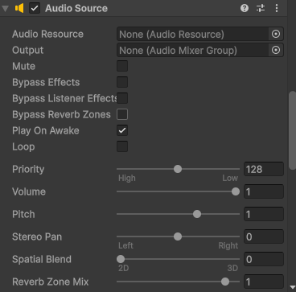
24. AUDIO
I create an Audio folder in Assets and import audio clips (engine hum, shoot, explosion, music).
I create an AudioManager (singleton) or attach AudioSource components on appropriate prefabs:
Ship: AudioSource for engine loop (set loop = true, playOnAwake = false).
Shot prefab: AudioSource.PlayOneShot(fireClip) in ShipWeapons.Fire().
Explosion prefab: AudioSource on particle prefab to play explosion sound.
I create an AudioMixer if I want volume groups (Music, SFX).
After I applied the audio, I started playing it to try: I press Play and verify engine loop, shooting sound, and explosion sounds play at correct events.

Slide 27
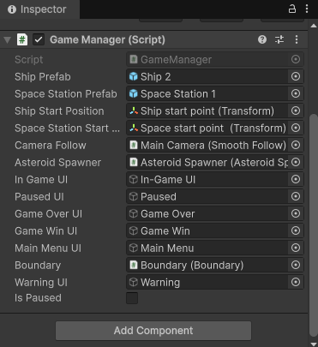
25. TIE EVERYTHING IN GAMEMANAGER
I MAKE GAMEMANAGER A SINGLETON (OR ENSURE ONLY ONE EXISTS).
2. I ASSIGN _SHIPPREFAB, _SPACESTATIONPREFAB, _SHIPSTARTPOSITION, _SPACESTATIONSTARTPOSITION, _CAMERAFOLLOW, _ASTEROIDSPAWNER, _INGAMEUI, _PAUSEDUI, _GAMEOVERUI, _GAMEWINUI, _MAINMENUUI, WARNINGUI, AND BOUNDARY IN THE INSPECTOR.
3. I IMPLEMENT STARTGAME(), SHOWMAINMENU(), GAMEOVER(), GAMEWIN() AND ENSURE STARTGAME() CALLS TIMER.STARTTIMER() AND THE GAMEOVER/GAMEWIN STOPS THE TIMER.

Slide 28
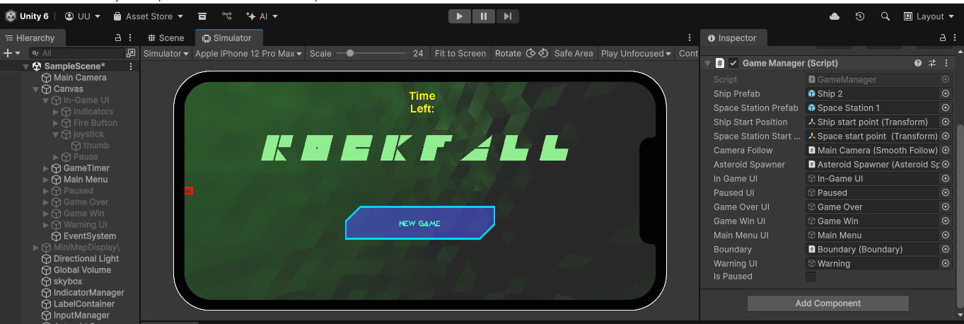
26. QUICK TESTING CHECKLIST
I PRESS START IN UNITY EDITOR.
I PRESS THE ON-SCREEN JOYSTICK AND CONFIRM THE SHIP MOVES & TURNS.
I PRESS FIRE AND VERIFY BULLETS SPAWN, HAVE A VISIBLE TRAIL, AND DESTROY ASTEROIDS.
I LET THE TIMER EXPIRE AND CONFIRM GAMEMANAGER.GAMEWIN() RUNS AND SHOWS THE WIN UI.
I COLLIDE SHIP WITH ASTEROID TO VERIFY GAMEOVER() TRIGGERS AND SHOWS THE GAME OVER UI.
I CLICK RESTART/NEW GAME AND CONFIRM EVERYTHING RESETS: SHIP SPAWNED AT START POINT, TIMER RESTARTS, PANELS HIDDEN, TIME.TIMESCALE RESET TO 1.

Slide 29
THANK YOU

